Slide 1
Procure-2-Receipt (P2R) Indirect Indirect X | Objectives
(Gen) AI capabilities Decision guidance for requesters and approvers
Automation
High E2E automation of Procure2Receipt process
Aspiration:
Indirect X is a leaner, less complex and more user-friendly solution
Integration
myMall & Indirect X seamlessly integrated
SHERPA X
Indirect X is embedded in SX ecosystem
Usability
Modern UI consistent from Procure2Receipt for improved UX
Reduced Complexity
Aligned complexity reduction compared to today’s processes

Slide 2

Procure-2-Receipt (P2R) | Indirect Situation and implications for companies / increments
Company / Accounting Unit (AUN) Sherpa-X Business Type (BT)
SRE Germany ARE 426q / AUN 3003 BT | Governance Foundation
Denmark Mobility ARE 526w / AUN 3012 BT | Project
Romania Factory Buzias ARE 539d / AUN 3014 BT | Product
Next47 ARE „UK“ BT | Governance Foundation
OneSRM enabled: “Use current Standard”
Not OneSRM enabled: “Start incremental North Star journey”
Focus

Slide 3
SHERPA X Release Master Plan ERP-Core Systems / Scenarios SAP Releases 2022 and 2023, Releases & Feature Packs
We plan with two Major Releases (1310 and 1320) and four Minor Releases (1221, 1222, 1311, 1312)
Major
Release
1310
11./12.05.
Minor Rel.
1312**
08.08.
Major
Release
1320
19./20.10.
Minor Rel.
1221
16.11.
Minor Rel.
1222
20.02.***
Minor Rel.
1311
13.06.
Releases
Realization
Freeze
Realization
Freeze
User Acceptance Test
Deploy
User Acceptance Test
Deploy
2023/ 2024 | 28.08.-15.09. | 18.09.-06.10. | 09.10.-27.10. | 30.10.- 17.11. | 27.11.-15.12. | 18.12.-05.01. | 08.01.-26.01. | 29.01.-16.02. | 26.02.-15.03. | 18.03.-05.04. | 08.04.-26.04. | 29.04.-17.05. | 27.05.-14.06. | 17.06.-05.07. | 08.07.- 26.07. | 29.07.-16.08.
SAP Re-leases
Waves
Sprints
Planning Weeks
28.08.-1.09
20.-24.11
19.-23.02
20.-27.05
19.-23.08
SAP Rel. 2022
SAP Rel. 2023
Wave 7
Wave 8
Wave 9
Wave 10
Deploy
S1
S2
S3
S4
S1
S2
S3
S4
S1
S2
S3
S4
S1
S2
S3
S4
Feature Packs
2210
2211
2212
2213
2214
2215
Start Upgrade SAP
Release
2301
2302
2303
2304
2305
2306
2307
2308
2309
*
*
Major Release
Minor Release

Slide 4
Procure-2-Receipt (P2R) Indirect Pilot GoLive „Buzias“: New Global Solution “Indirect X”
Workflow Steps
myMall
SAP (S4/BTP)
SCM Star

Slide 5


Slide 6
Demo : Indirect X Process Steps
myMall
Create Requirement (SC)
BTP
Complete Requirement (PR)
Approve the PR/PO
S4 HANA
Manage PR
Manage PO
Send PO to Supplier (Automatic)
Post Goods Receipt
Automatic e-mail notification trigger
Reverse the GR

Slide 7
1320: Hypercare Support issues (Indirect X)
myMall to S4 Interface : myMall to S4 inbound connection is not working- Resolved
21.10: Issue is reported to the interface team.
BTP Workflow not triggering- Resolved
21.10: BTP team is checking the issue.
S4 to myMall connection (OCI) Connection- Connection is working fine but Supplier (IFA) field value mapping IFA to BP is required (New requirement): Workaround is available.
21.10: Received a 404 Forbidden error while transferring items from myMall to S4. Reason: OData service update was not completed; it started working after some time.
22.10: RFC_Azure SNC is updated, but the issue is not resolved.
23.10: Investigation is still ongoing from the EAI side and basis side.
24.10: Investigation is still ongoing from the EAI side and basis side.
25.10: Defect 8500011844 in Solman was created and assigned to Hima (Infosys).
28.10: Ticket 6000120884 was created to assign the myMall to the RFC_AZURE user.
29.10: Even after assigning the role, the issue is not resolved, so basis (Norbert) will raise a high priority incident to SAP.
30.10 : 404 Error : need to change SMICM Parameter change for server port 5 - done but issue is not resolved, Stan from interface side still checking it.
05.10 : Issue is resolved after changing the port 5 and activating the ICF node /default_host/sap/bc/soap/rfc in S4 line, old messages were cleared.
22.10: Version mismatch (missing decision table) found.
23.10: Problem with deployment of an artifact on SAP Build Process Automation where the workflow deployment is stuck for an unknown reason. High priority ticket 1082584/2024 is raised to SAP.
24.10: BTP Platform team is following up with SAP.
25.10: Issue got escalated and we are waiting for a fast resolution from SAP/BTP side.
28.10: BTP workflow, mail notification, and automatic PO creation worked during the smoke test. PO 4500103924 was created via OCI.
22.10: OCI value mapping issue: myMall is sending the supplier IFA number to S4, and the requester has to change it to the BP number manually.
23.10: Supplier field mapping for OCI from myMall to S4 needs to be adjusted with BP.
24.10: Incident INC41584398 was raised to the myMall team to adjust the mapping.
25.10: As per WPS, it is not possible via standard field value mapping; they have suggested to use the custom field ZZW_VENDOR_IFA.
28.10: After maintaining the custom field ZZW_VENDOR_IFA in myMall, the issue was not resolved as this custom field doesn’t transfer to S4.
29.10: Checking with development for field mapping; most probably, an enhancement will be needed for OCI value mapping.
30.10 : Need to enhance the logic in S4 side by implementing the BADI.
05.10 :Project-REQ: 6000121549/INC 6000121626 is created and assigned to development team but it can’t be handled under bugfix, so feature & story is requested by Dev team.
06.10 : Story SX-91313 is created to development team under OCI feature SX-91234 enhancement.

Slide 9
Back Up Slide

Slide 10
Procure-2-Receipt (P2R) | Indirect Simplified Architecture overview
SAP S4
AIF (myMall)
FLP
PR / PO / GR (System of records)
myMall
Catalogs
Shopping Cart
PR creation
SAT
Approver data
Get SAT GIDs
PR, PO, GR feedback
PR / PO events
Various APIs*
SAP BTP
PA forms**
FLP
Apps (PO Change)
SCM STAR
RFQ processing
Initiate RFQ
Get RFQ results
*) PR change, PR release, PO creation, PO change, PO release, Asset creation, GET calls for supplier, value helps, user data, etc.
**) Requester completion, Supplier selection, Purchaser, Asset Expert, Func/Comm approver, Support

Slide 11
OCI Punchout Process
Requester can create the PR in S4 by using the OCI catalog myMall from SAP S4 HANA system.
S4
myMall
S4
6.Choose the item from available catalog items.
Catalog item details transfers to S4.
7. Finalize shopping basket
2.Click on create.
5.Choose relevant myMall webservice.
Adding multiple items are possible.
IFA to Business Partner of supplier mapped automatically.
Complete the PR.
1.Go to manage Purchase Requisition Professional fiori app
3.Click on create at line-item level
4.Select Items from from external catalogs.

Slide 12
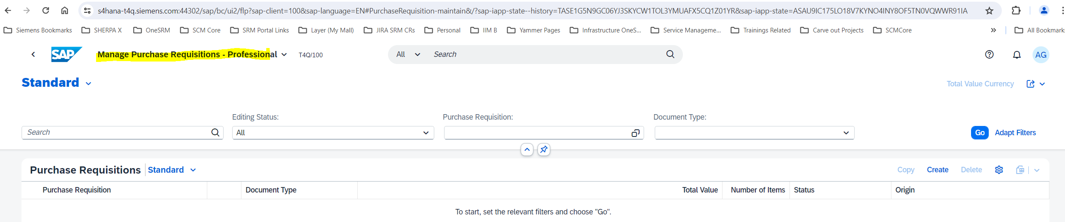
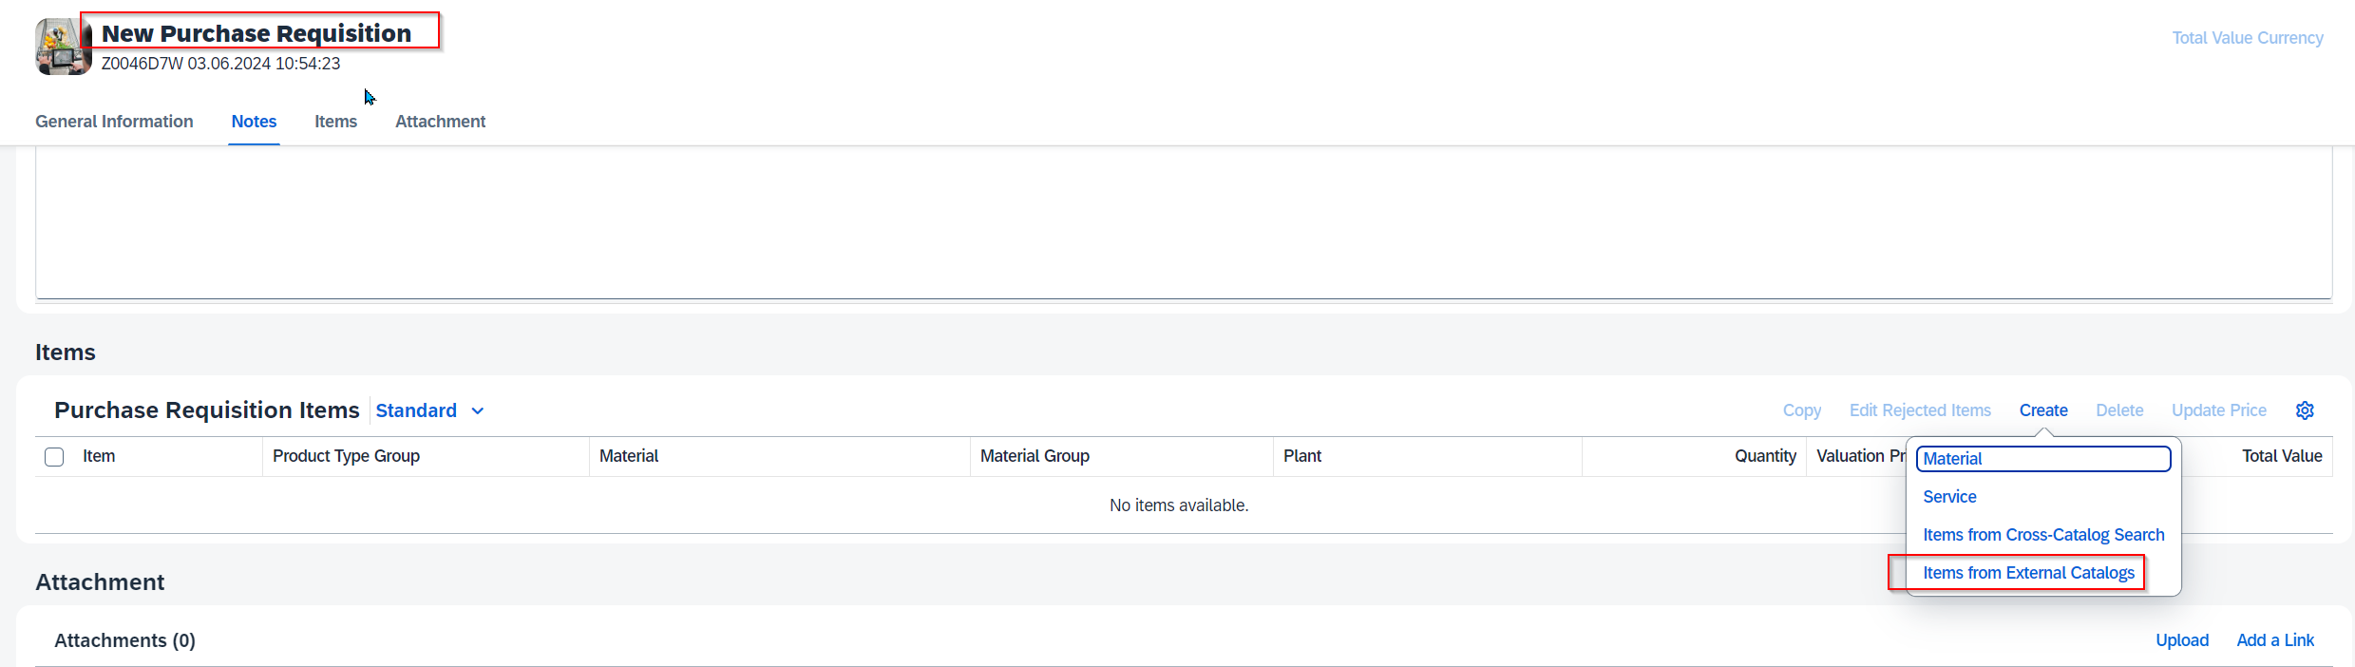
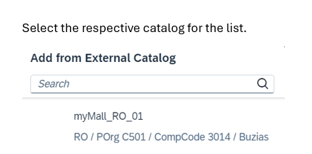
OCI Process Steps
1
2
3
4
5

Slide 13
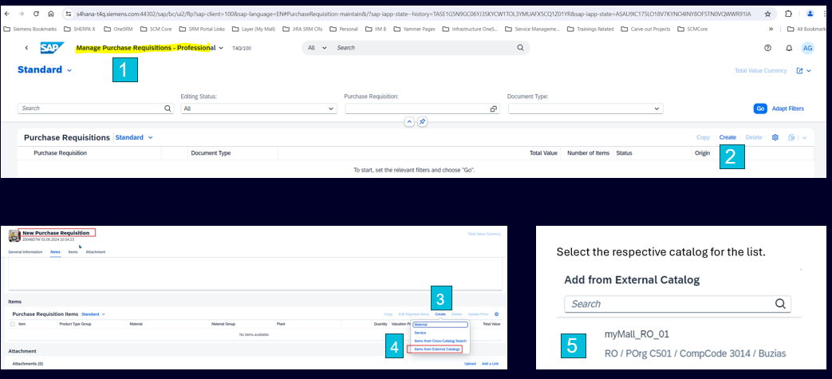
Go to manage Purchase Requisition Professional fiori app
Click on create.
Click on create at line-item level
Select Items from external catalogs.
Choose relevant myMall webservice
Choose the item from available catalog items.
Finalize shopping basket

Slide 14
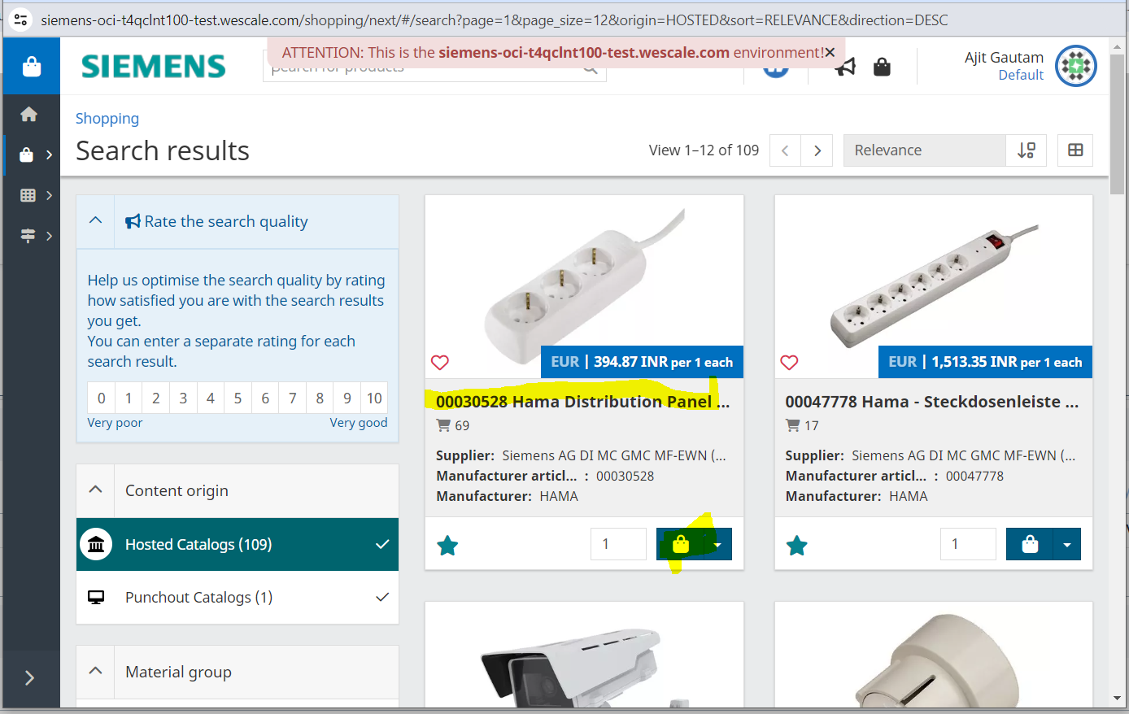
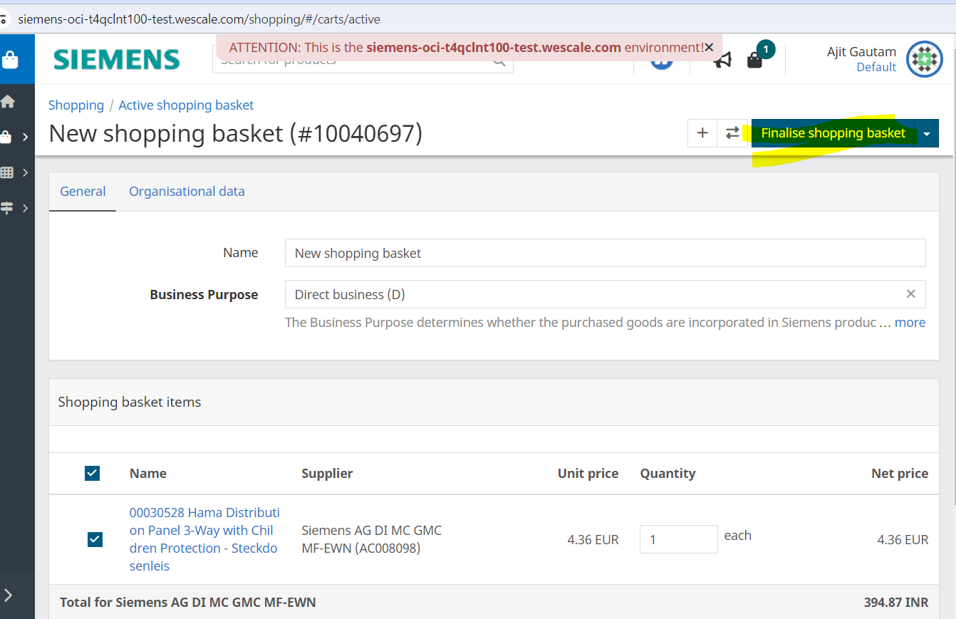
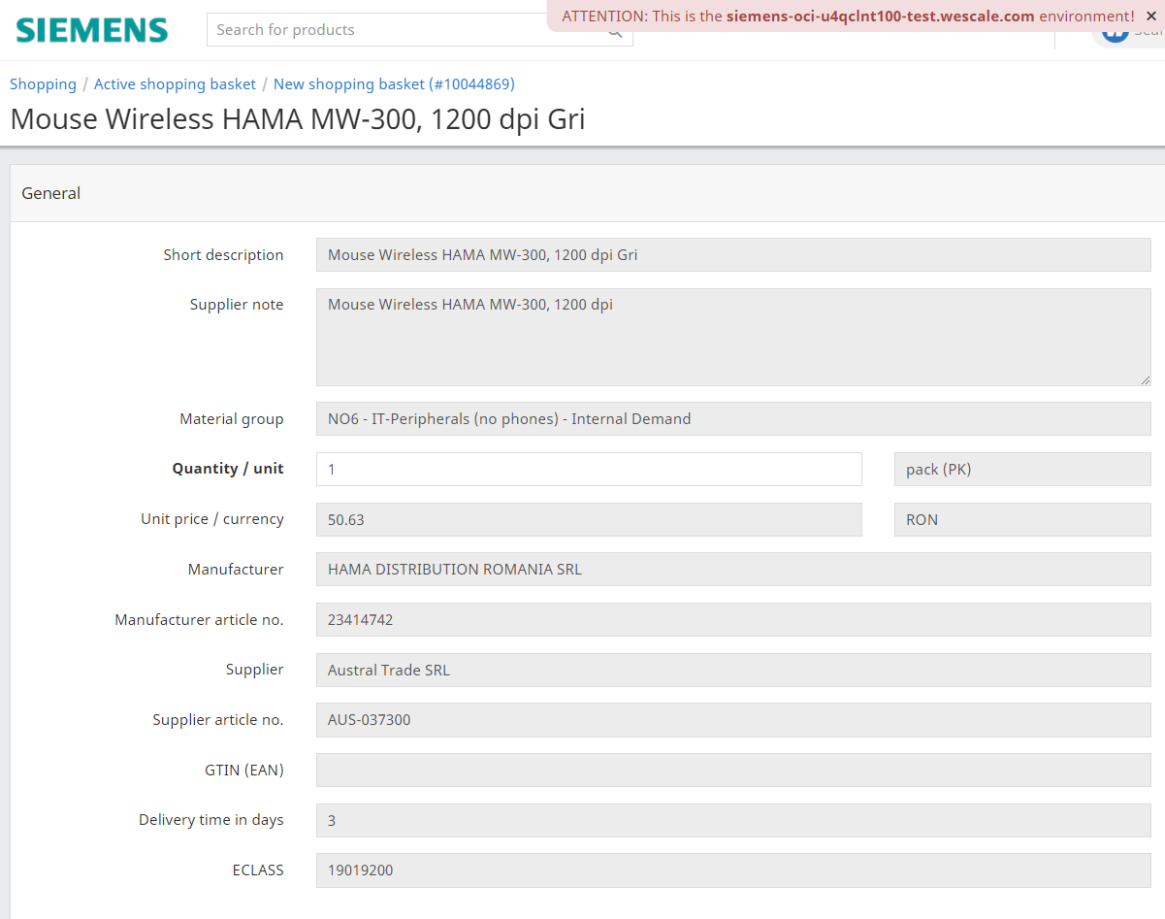
Process Steps Continue
7
6

Slide 15
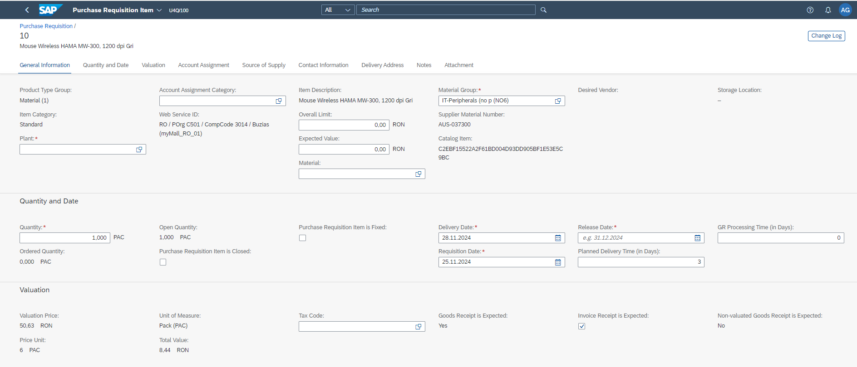
S4 Item Details after punchout

Slide 16
myMall and S4 fields
myMall Fields | Name | S4 Fields
 | Short description | Item Description | Mina pix Wave Albastru
 | Supplier note | Item Text | Mina pix Wave
 | Material group | Material group
 | Quantity / unit | Price Unit
 | Unit price / currency | Valuation Price
 | Manufacturer
 | Manufacturer article no.
 | Supplier | Fixed Supplier | Business Partner number
 | Supplier article no | Supplier Material Number | AUS-002295
 | Delivery time in days | Planned delivery time
 | ECLASS
 | Organization data | Catalog Item
 |  | Requisition Date
 |  | Delivery Date
 |  | Goods Receipt is Expected | Yes
 |  | Non-valuated Goods Receipt is Expected | No

Slide 17

Procure-2-Receipt (P2R) | Indirect PR/PO Release Strategy – Interaction between BTP-PA and S4
Workflow Step 1 (Purchaser)
Workflow Step 2 (Expert 1)
Workflow Step 3 (Expert 2)
Workflow Step N (Commercial Approver)
Control and execution of individual workflows per unit
Submit PR/PO for processing, document result and follow-up (e.g. printout)
BTP-PA
…
1-step Release Strategy for technical purpose only
SAP S4
Use full flexibility of BTP-PA to define any kind of workflows based on S4 documents PR and PO
S4 is customized within SAP standard and only start and end of workflow represented in Release Strategy
Users will not be impacted by that because release is controlled from BTP-PA in background
Page 17

Slide 18
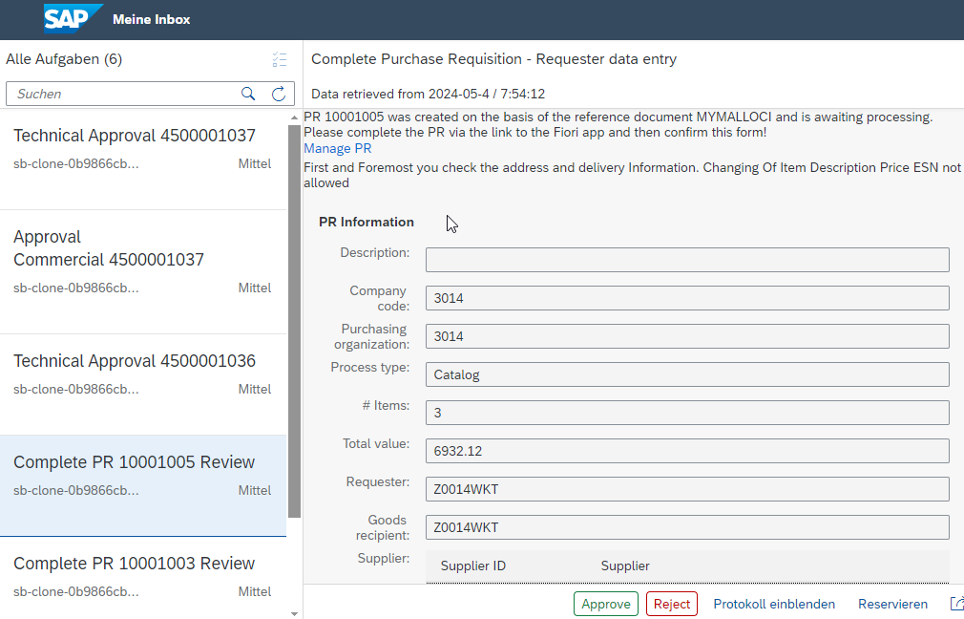
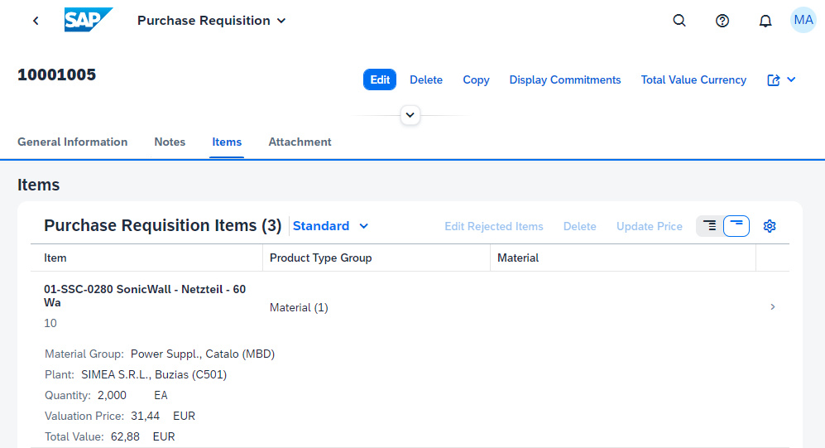
Procure-2-Receipt (P2R) | Indirect Interaction BTP-PA Workflow step and S4 Fiori app usage
Check BTP-PA form and jump to S4 Fiori app
Update document in S4 fiori app
Approve / Reject BTP-PA form
1
2
3
Page 18

